Slide 1


Cyberbullying Detection
By:
John Hani
Mohamed Nashaat
Mostafa Ahmed
Zeyad Emad
Under supervision of :
Dr. Eslam Amer
Eng. Menna Gamil

Slide 2

Agenda
Introduction
Related work
Problem Statement
System overview
Project Deliverables

Slide 3
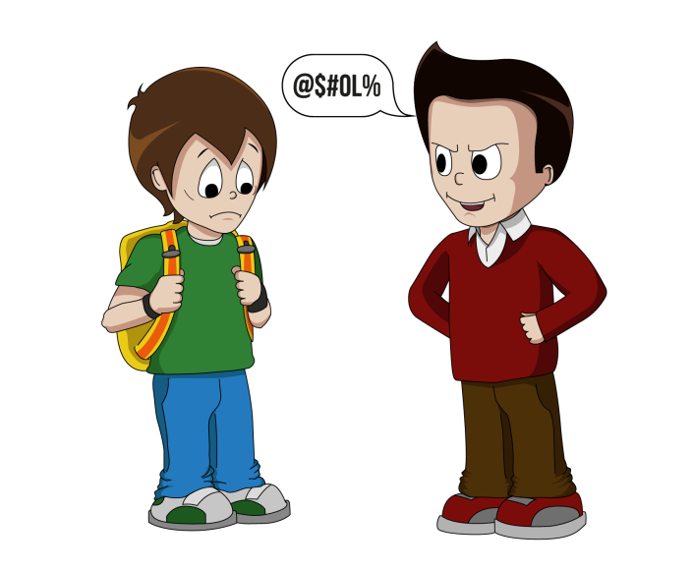


Introduction
Use superior strength or influence to intimidate someone

Slide 4
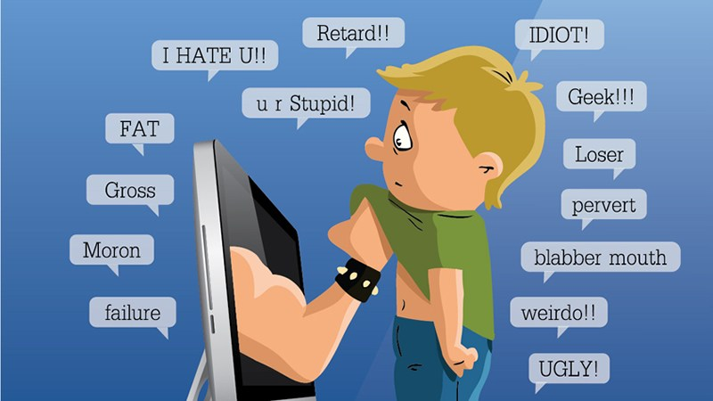

Introduction Cont.
Cyberbullying has been manifesting our youth for quite sometime, due to them being involved in one form of social media communication or another.
Sarcasm which the use of irony to mock or
convey contempt.
More than 1 in 3 young people have experienced
cyber threats online.
Over 25 percent of adolescents and teens have been
bullied repeatedly through their cell phones or the Internet.
National Crime Prevention Council, “Cyberbullying”
i-SAFE Inc., “Cyber Bullying: Statistics and Tips”
Richard Webster, Harford County Examiner, “From cyber bullying to sexting: What on your kids’ cell?”

Slide 5
Related Work
Experts and Machines Against Bullies: A Hybrid Approach
to Detect Cyberbullies
Main Problem
They focused on the detection of bully users in online social networks and the efficiency of both expert systems and machine learning models for identifying the potential bully users.
Contribution
They used three machine learning methods: a Naive Bayes classiﬁer, a classiﬁer based on decision trees and Support Vector Machines (SVM) with a linear kernel
Precision
The discrimination capacity of the MCES was 0.72

Slide 6
Related Work Cont.
Machine Learning Approach for Detection of Cyber-Aggressive
Comments by Peers on Social Media Network
Main Problem
There are challenges like: special characters in comments and the detection of insults and offensive comments
Contribution
They proposed 2 new hypotheses for detecting cyberbullying and it has increased the precision by 4 percent.
Precision
70.0% precision using SVM
64.0% precision using logistic regression

Slide 7
Related Work Cont.
A Pattern-Based Approach for Sarcasm Detection on Twitter
Main Problem
It’s hard even for humans to detect sarcasm. Therefore, recognizing sarcastic statements can be very useful to improve automatic sentiment analysis of data.
Contribution
-They proposed efficient way to detect sarcastic tweets to improve sentiment analysis.
-They used NPL and SVM for classification.
Precision
Accuracy 83.1%
Precision 91.1%

Slide 8
Problem Statement
Data in the internet nowadays are too huge to be monitored manually by humans to detect cyberbullying.
In previous cyberbullying detection frameworks there has been a problem in detecting false positive cyberbullyings cases.
So we aim to Enhance the accuracy of cyberbullying detection using natural language processing and contextual analysis.
In cyberbullying detection frameworks they cant detect sarcasm so we aim to detect sarcasm along with cyberbullying.

Slide 9
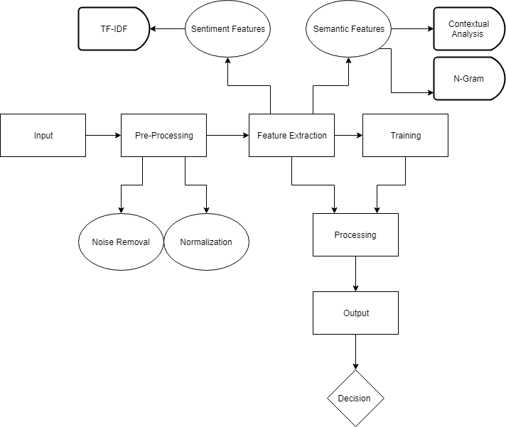
Overview diagram

Slide 10
Pre-processing text (Noise Removal)
<h1>THIS IS A TEST MESSAGE \N</h1>
Strip HTML
THIS IS A TEST MESSAGE \n
Remove Encoding Parts
THIS IS A TEST MESSAGE
Lower Text
this is a test message
Tokenize Text
[this , is , a , test , message]
Notes:
<number>

Slide 11
Pre-processing cont. (normalization)
These are 2 test messages
Replace Numbers
These are two test messages
Remove Stop Words
[two , test , messages]
Stemming
[two , test , messag]
Lemmatization

Slide 12
Feature extraction
Sentiment Features
Semantic Features
TF-IDF
N-Grams
Contextual Analysis

Slide 13
Processing
Classifiers
SVM
Random Forest
According to the Accuracy , embed Deep Learning Methods

Slide 14
Demo

Slide 15
Any Questions?

